Slide 1
Spring Security
Banuprakash C
banu@lucidatechnolgies.com
banuprakashc@yahoo.co.in

Slide 2
3 Key Areas of Security
Authentication
Authentication functionality identifies a user and thus prevents unauthorized access.
Authorization
Authorization functionality controls the access to system resources according to the authority of the authenticated (logged-in) user.
Exception Handling

Slide 3
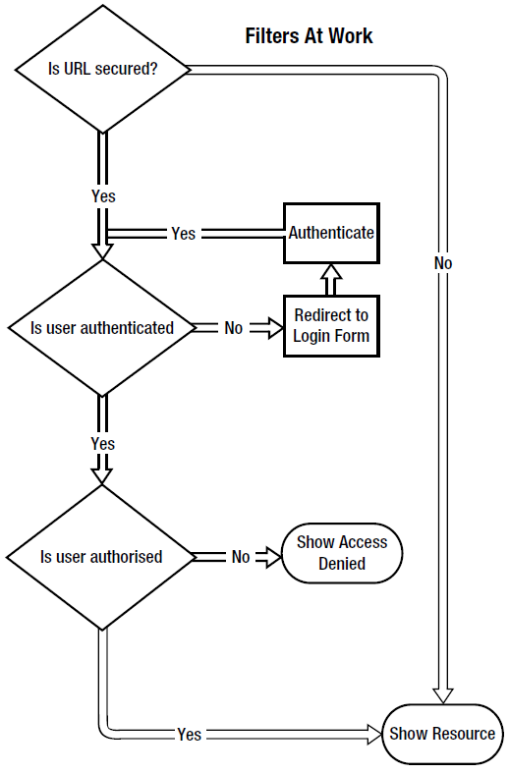
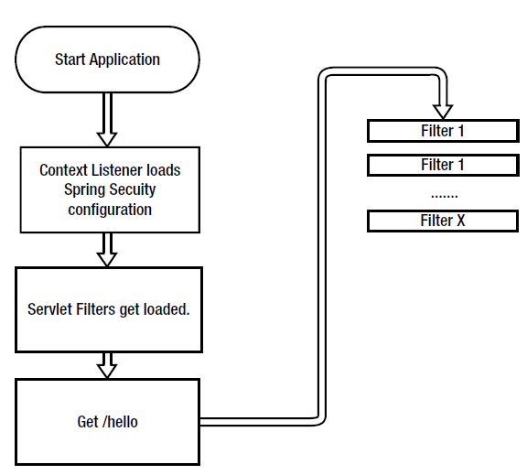
Spring Security Architecture
Spring Security from load up to first request

Slide 4
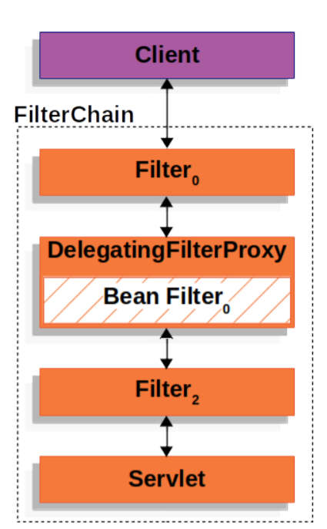
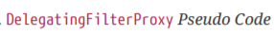
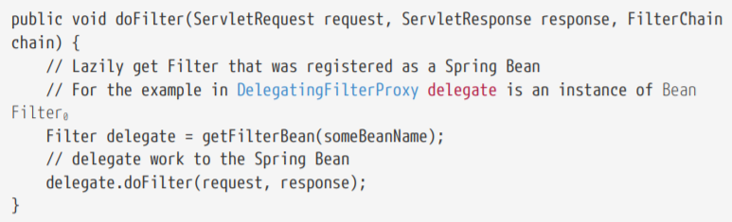
DelegatingFilterProxy
Spring provides a Filter implementation named DelegatingFilterProxy that allows bridging between the Servlet container’s lifecycle and Spring’s ApplicationContext.

Slide 5
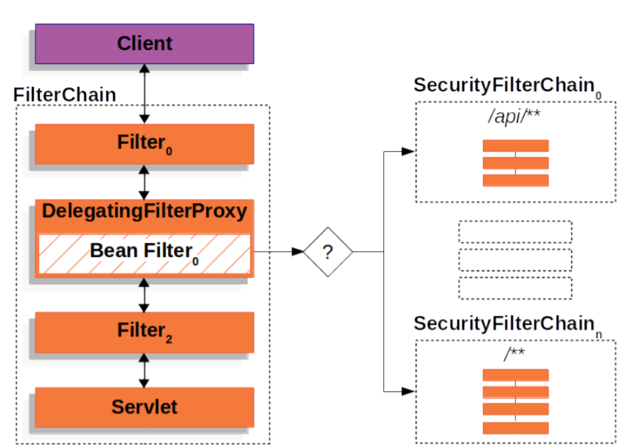
SecurityFilterChain
SecurityFilterChain is used by FilterChainProxy to determine which Spring Security Filters should be invoked for this request.

Slide 6
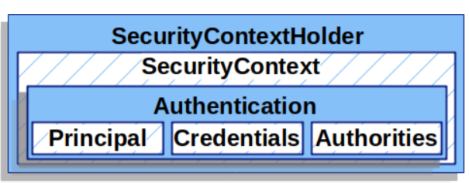
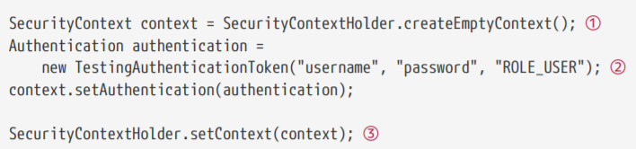
SecurityContextHolder
The SecurityContextHolder is where Spring Security stores the details of who is authenticated.
① Create an empty SecurityContext
② Create a new Authentication object.
Spring Security does not care what type of Authentication implementation is set on the SecurityContext.
③ Finally, we set the SecurityContext on the SecurityContextHolder.
Spring Security will use this information for authorization.

Slide 7
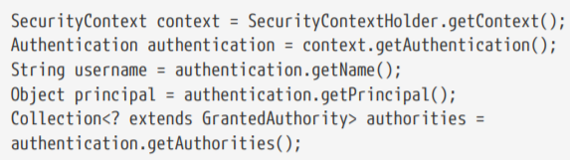
SecurityContextHolder
Access Currently Authenticated User

Slide 8
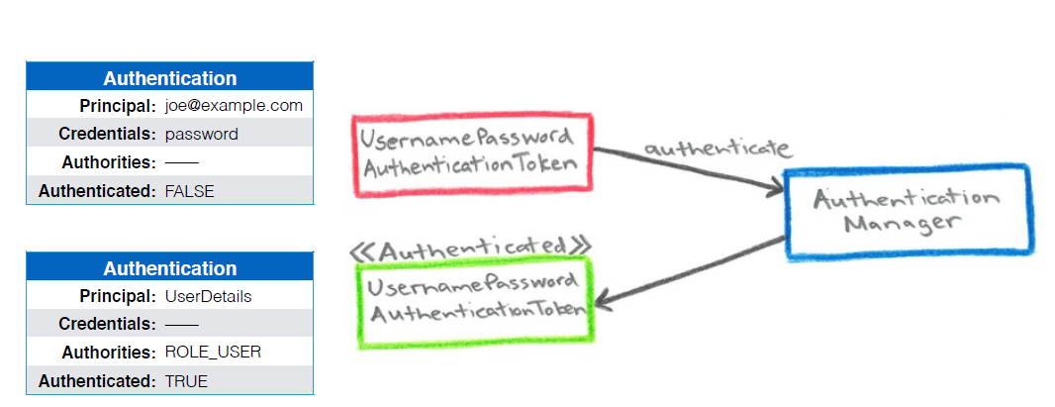
Authentication
The Authentication serves two main purposes within Spring Security:
An input to AuthenticationManager to provide the credentials a user has provided to authenticate.
Represents the currently authenticated user. The current Authentication can be obtained from the SecurityContext.

Slide 9
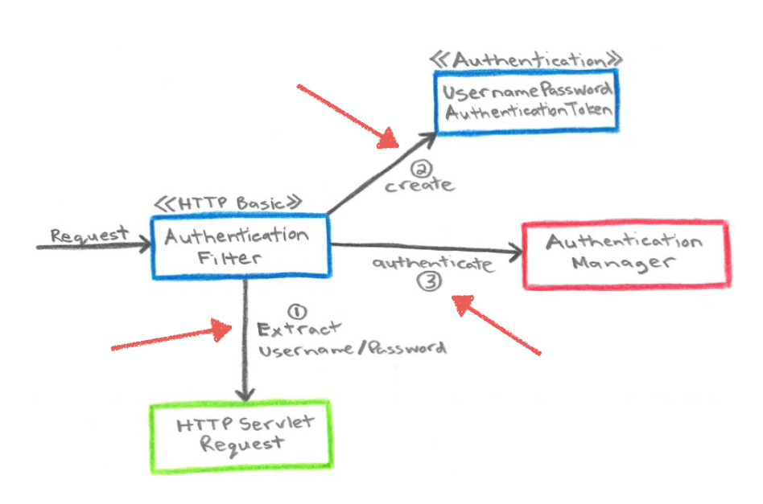
Authentication Filter
Spring Security's web infrastructure is based entirely on standard servlet filters.
It deals in HttpServletRequests and HttpServletResponses and doesn't care whether the requests come from a browser, a web service client, an HttpInvoker or an AJAX application.

Slide 10
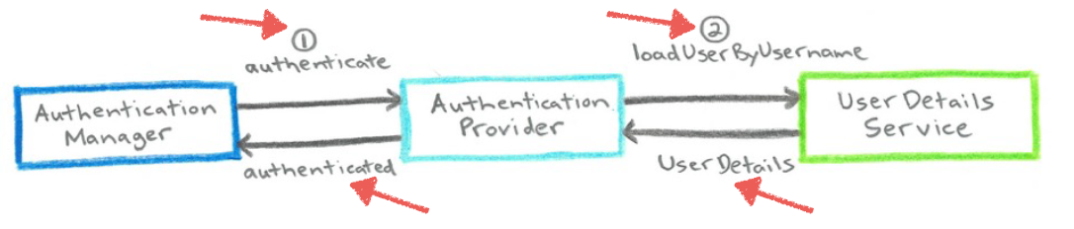
AuthenticationManager
AuthenticationManager is the API that defines how Spring Security’s Filters perform authentication.
ProviderManager is the most commonly used implementation of AuthenticationManager.
ProviderManager delegates to a List of AuthenticationProviders.

Slide 11
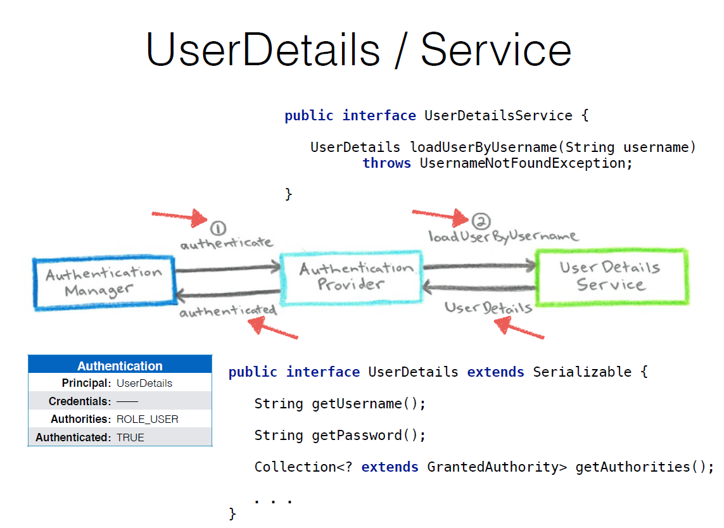

Slide 12
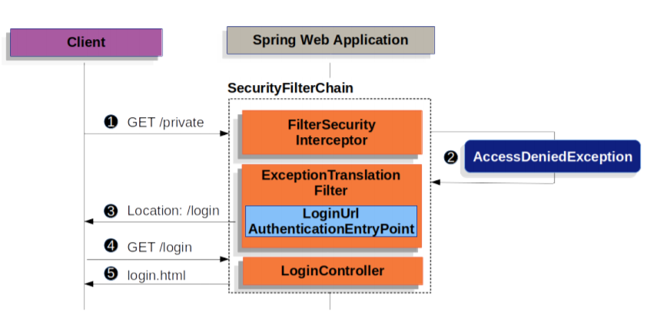
Form Login: Redirecting to the Log In Page
First, a user makes an unauthenticated request to the resource /private for which it is not authorized.
Spring Security’s FilterSecurityInterceptor indicates that the unauthenticated request is Denied by throwing an AccessDeniedException.
Since the user is not authenticated, ExceptionTranslationFilter initiates Start Authentication and sends a redirect to the login page with the configured AuthenticationEntryPoint.
The browser will then request the login page that it was redirected to. Something within the application, must render the login page.

Slide 13
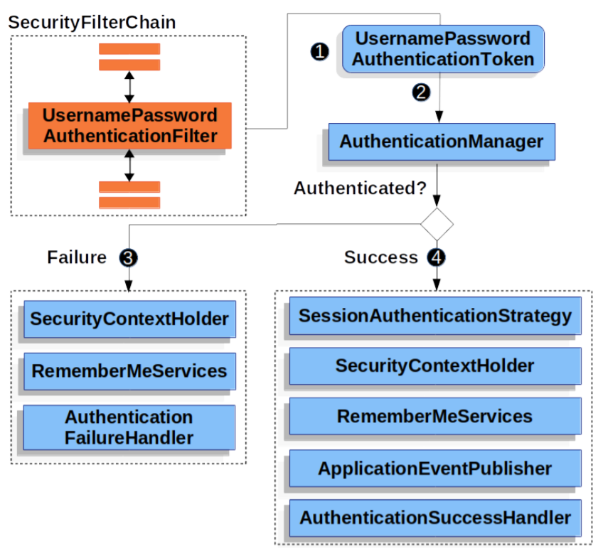
Form Login: Username/password submitted
If authentication fails:
The SecurityContextHolder is cleared out.
RememberMeServices.loginFail is invoked.
AuthenticationFailureHandler is invoked.
If authentication is successful:
SessionAuthenticationStrategy is notified of a new log in.
The Authentication is set on the SecurityContextHolder.
RememberMeServices.loginSuccess is invoked.
ApplicationEventPublisher publishes an InteractiveAuthenticationSuccessEvent.
The AuthenticationSuccessHandler is invoked. Typically this is a SimpleUrlAuthenticationSuccessHandler which will redirect to a request saved by ExceptionTranslationFilter when we redirect to the log in page

Slide 14
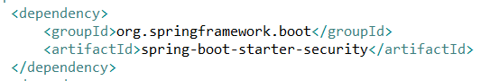
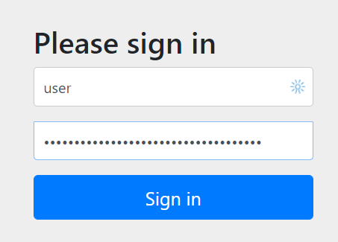
Spring Security to new Spring Boot project
To use Spring Security in Spring boot app you just need to add dependency:
No need to add any configuration
This adds mandatory authentication for all URLs
Adds a login form
Handles login error
Creates a user and sets a default password

Slide 15
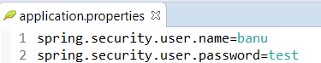
Spring Security to new Spring Boot project
Customize user and password
By adding this Spring security won’t generate default user and password

Slide 16
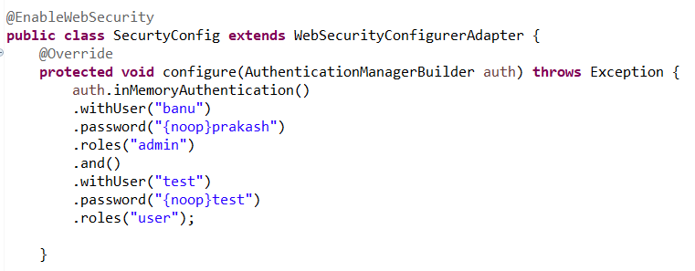
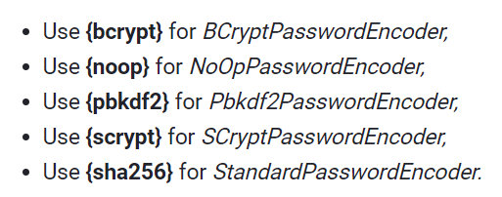
Configure In-Memory Users with Roles
Web Security With Java Configuration
To enable HTTP Security in Spring, we need to extend the WebSecurityConfigurerAdapter to provide a default configuration in the configure(HttpSecurity http) method:

Slide 17
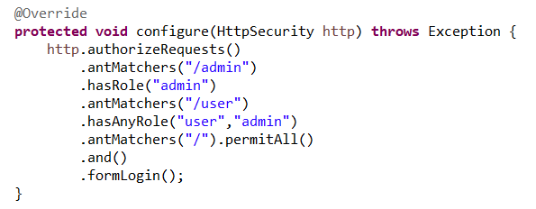
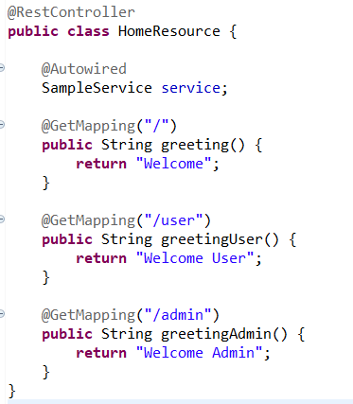
Configure In-Memory Users with Roles
Adding Authorization

Slide 18
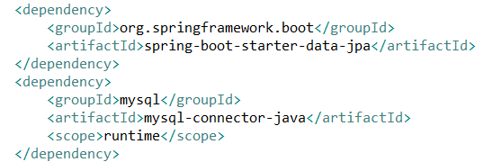
JDBC authentication
Add the following dependencies

Slide 19
Running MySQL on docker
docker pull mysql
docker run --name local-mysql –p 3306:3306 -e MYSQL_ROOT_PASSWORD=Welcome123 -d mysql
CONNECT TO A MYSQL RUNNING CONTAINER
Bash into the running container and run MySQL client.
Bash into the running MySQL container:
$ docker exec -t -i <container_name> /bin/bash
Run MySQL client:
$ mysql -u “<username>” -p

Slide 20
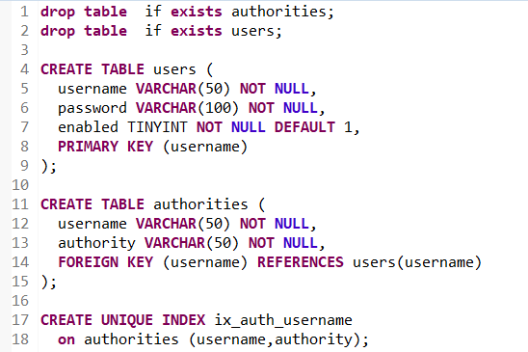
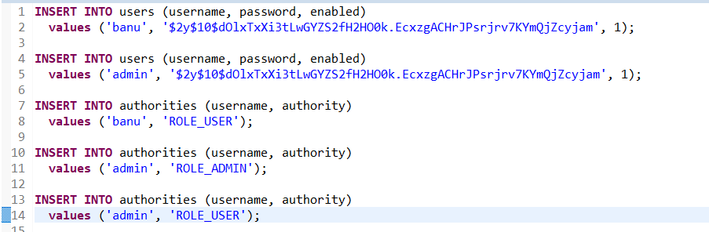
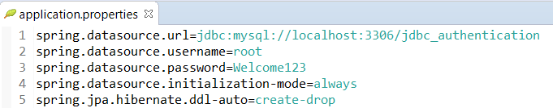
JDBC authentication
schema.sql
data.sql

Slide 21
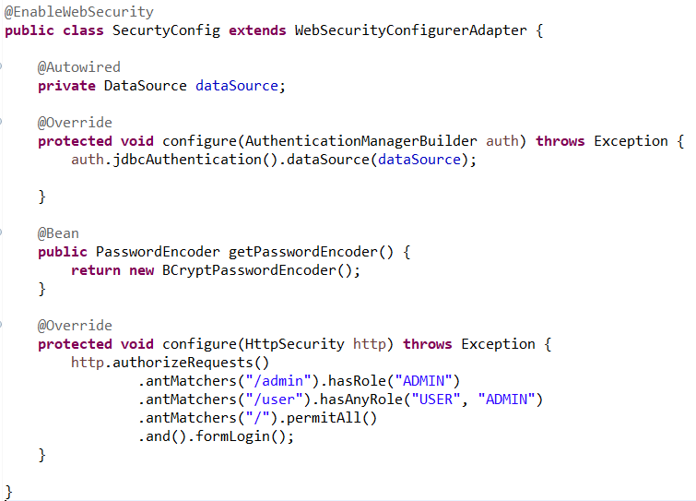
JDBC authentication: Configure jdbcAuthentication with BcryptPasswordEncoder

Slide 22
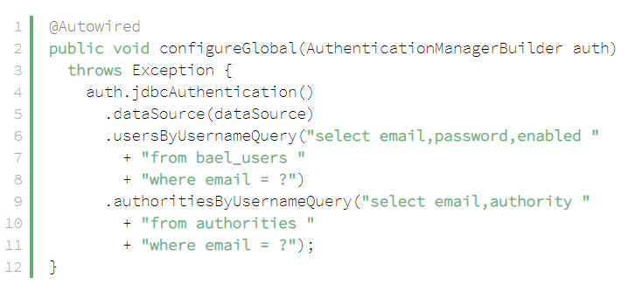
JDBC authentication
Customizing the Search Queries

Slide 23
Spring Method Security
we need to enable global Method Security:
@EnableGlobalMethodSecurity(
prePostEnabled = true,
securedEnabled = true,
jsr250Enabled = true)
The prePostEnabled property enables Spring Security pre/post annotations
The securedEnabled property determines if the @Secured annotation should be enabled
The jsr250Enabled property allows us to use the @RoleAllowed annotation

Slide 24
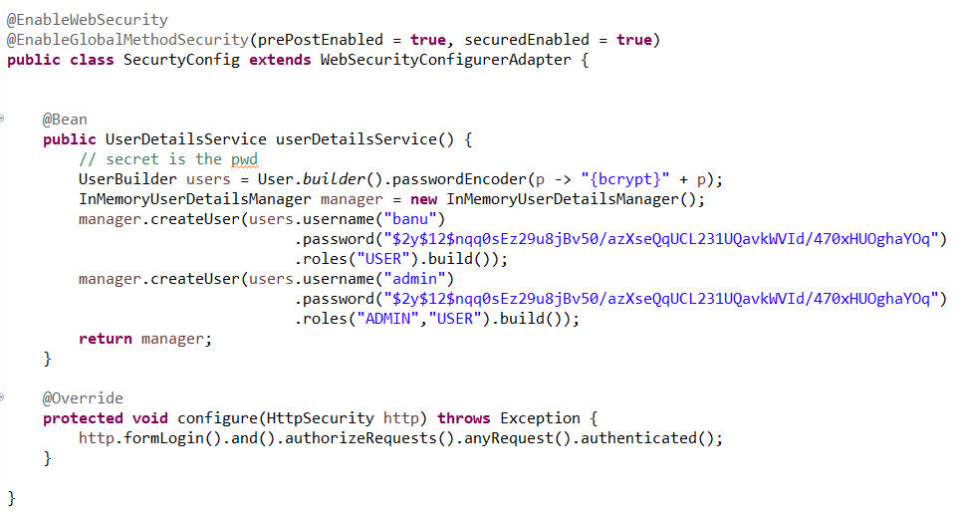
Spring Method Security: Configure

Slide 25
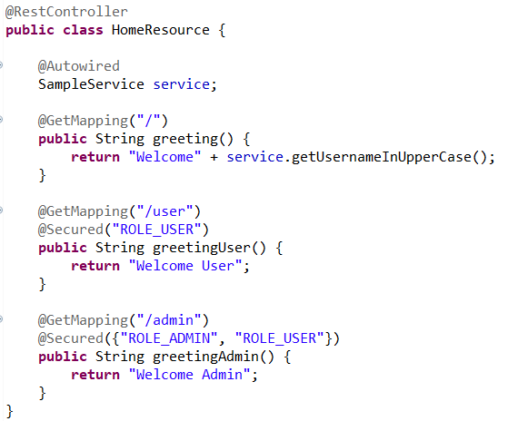
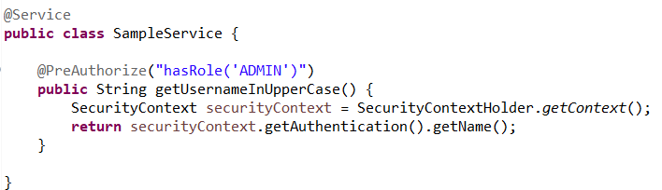
Spring Method Security: secure

Slide 26
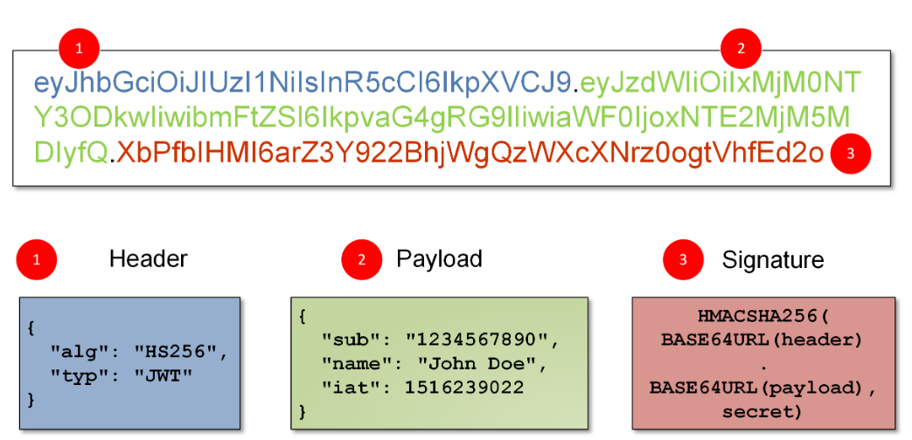
JSON Web Token (JWT)
JSON Web Tokens consist of three parts separated by dots (.), which are:
Header
Payload
Signature
JWT typically looks like the following:

Slide 27
JSON Web Token (JWT)
Header
The header typically consists of two parts:
the type of the token, which is JWT, and the hashing algorithm being used, such as HMAC SHA256 or RSA.
For example:
{
"alg": "HS256",
"typ": "JWT"
}

Slide 28
JSON Web Token (JWT)
Payload
The second part of the token is the payload, which contains the claims. Claims are statements about an entity (typically, the user) and additional metadata.
Reserved claims:
These are a set of predefined claims which are not mandatory but recommended, to provide a set of useful, interoperable claims.
Some of them are: iss (issuer), exp (expiration time), sub (subject), aud (audience), and others.
Public claims:
These can be defined at will by those using JWTs.
But to avoid collisions they should be defined in the IANA JSON Web Token Registry
Private claims:
These are the custom claims created to share information between parties that agree on using them.

Slide 29
JSON Web Token (JWT)
Signature
The signature is used to verify that the sender of the JWT is who it says it is and to ensure that the message wasn’t changed along the way. Putting all together

Slide 30
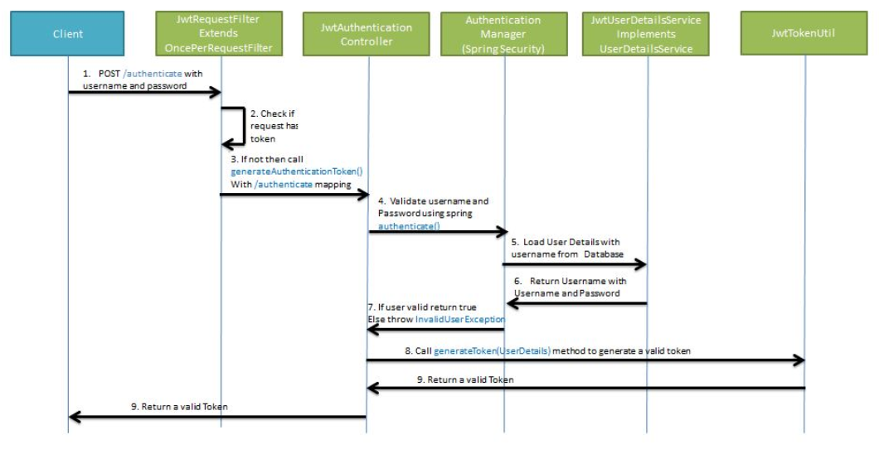
JSON Web Token (JWT) : Generating JWT

Slide 31
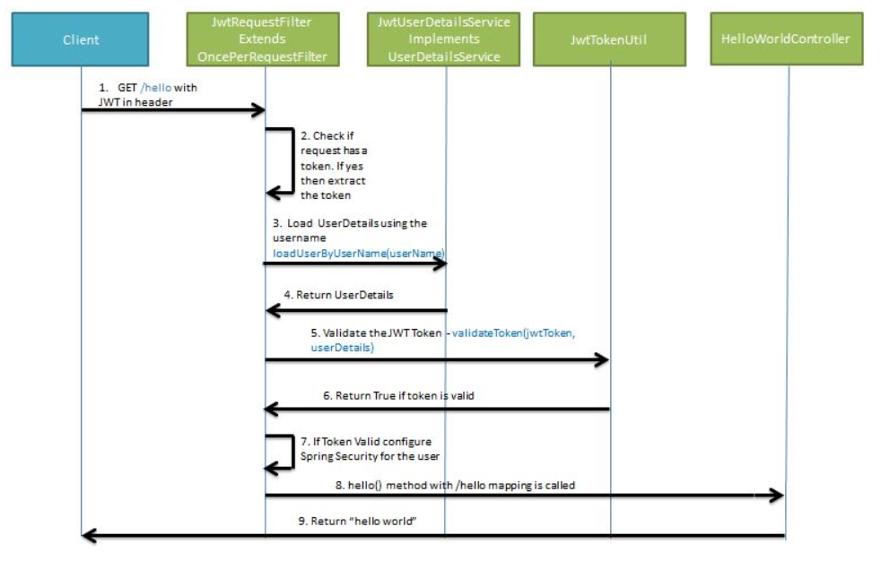
JSON Web Token (JWT) : Validating JWT

Slide 32
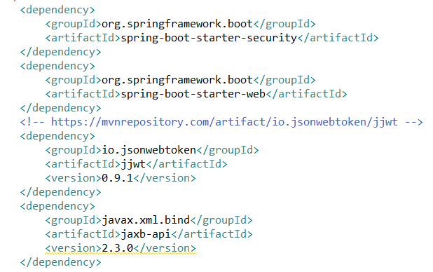
Spring Boot JWT: dependencies

Slide 33
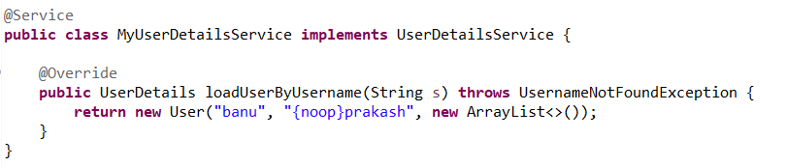
Spring Boot JWT: UserDetailsService

Slide 34
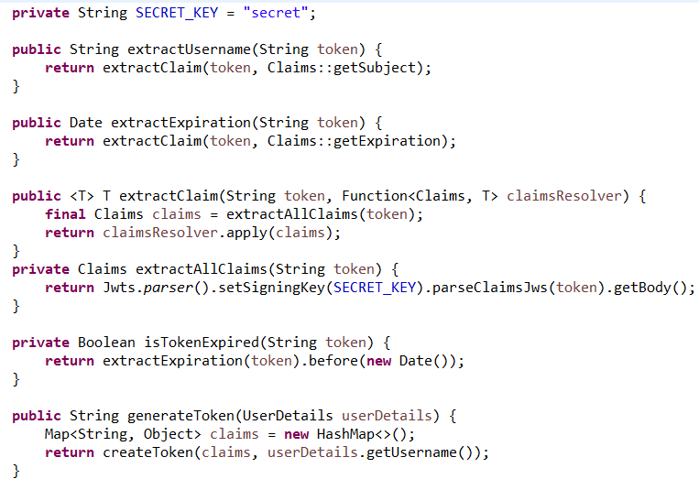
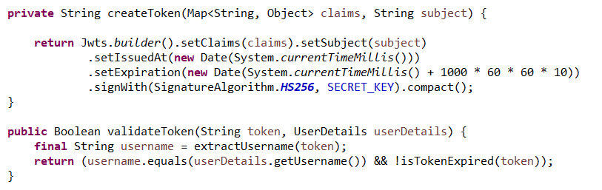
Spring Boot JWT: JwtUtilToken

Slide 35
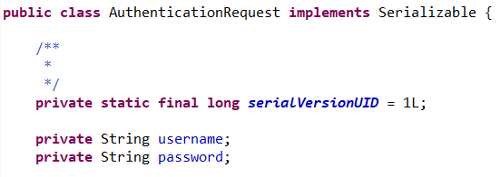
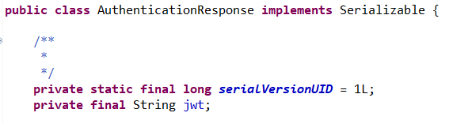
Spring Boot JWT: AuthenticationRequest and AuthenticationResponse

Slide 36
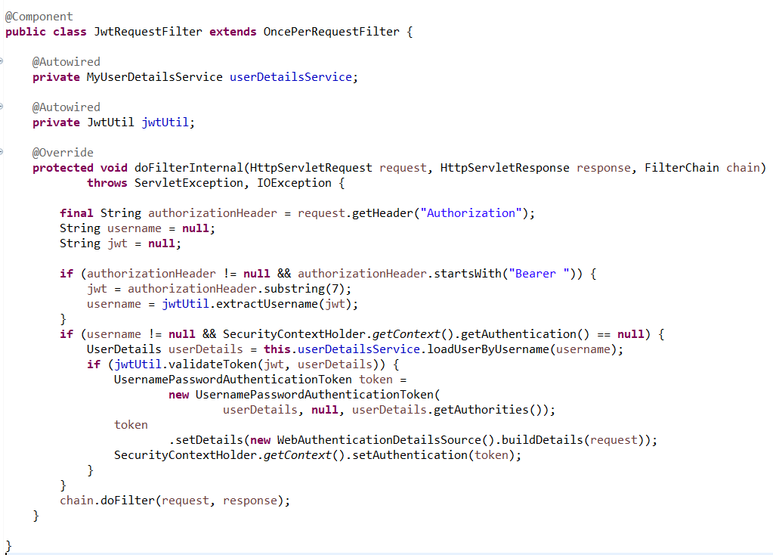
Spring Boot JWT: JwtRequestFilter

Slide 37
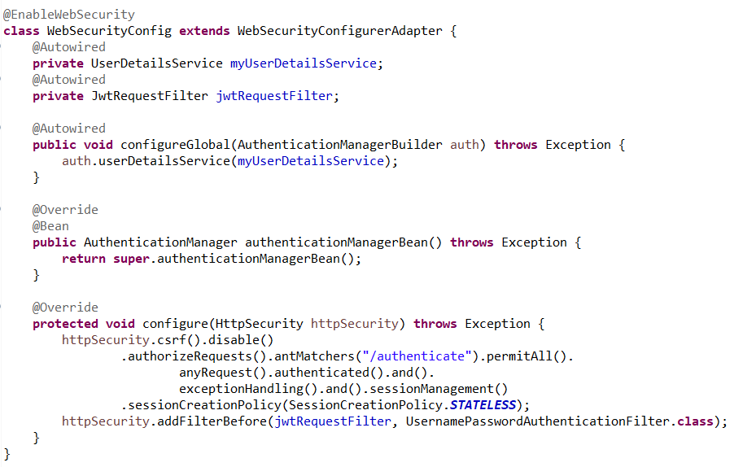
JWT: WebSecurityConfiguration

Slide 38
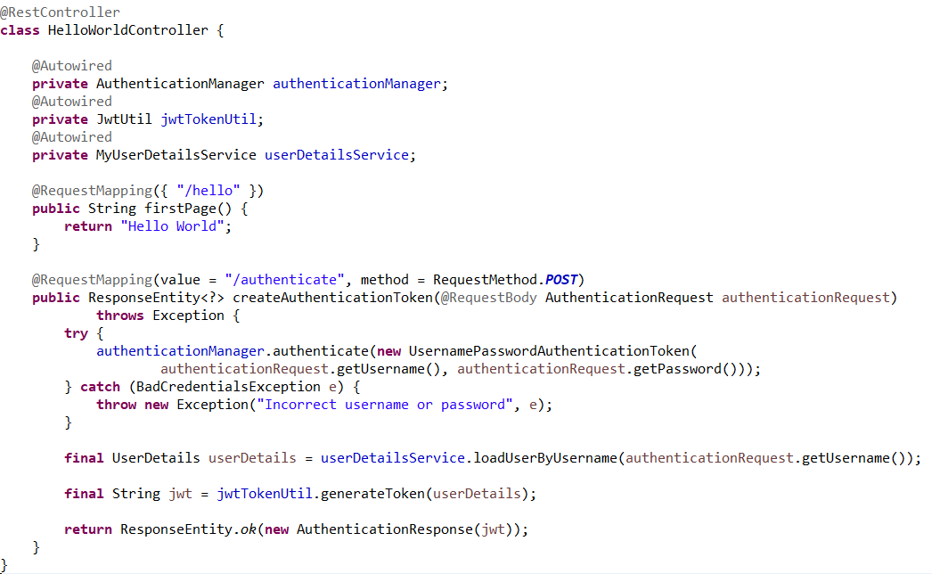
JWT: Controller

Slide 39
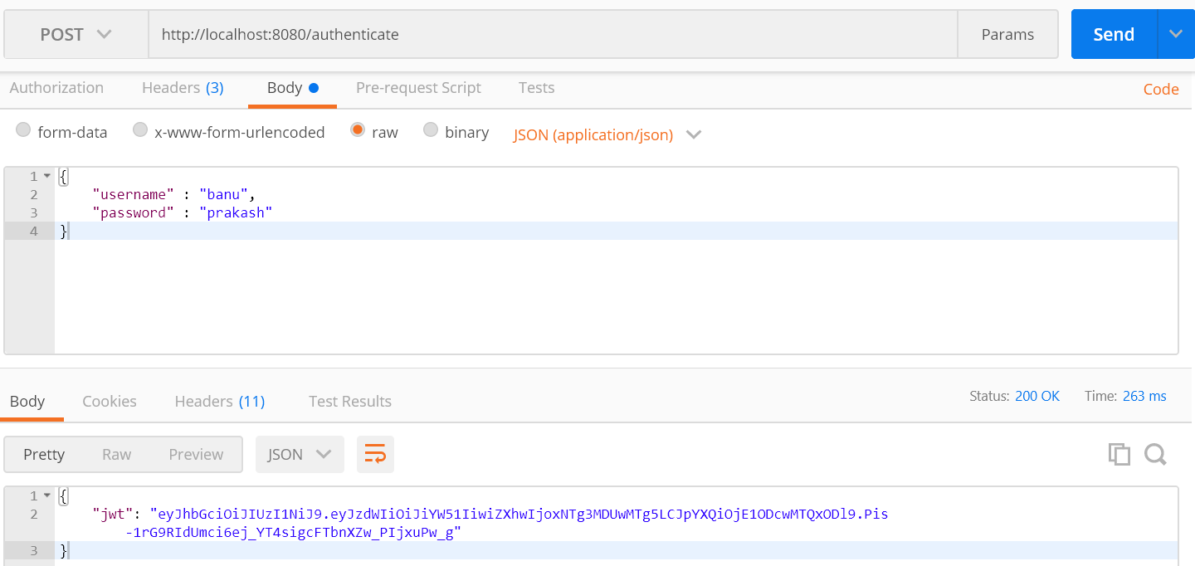
JWT: Login- Generate JWT

Slide 40
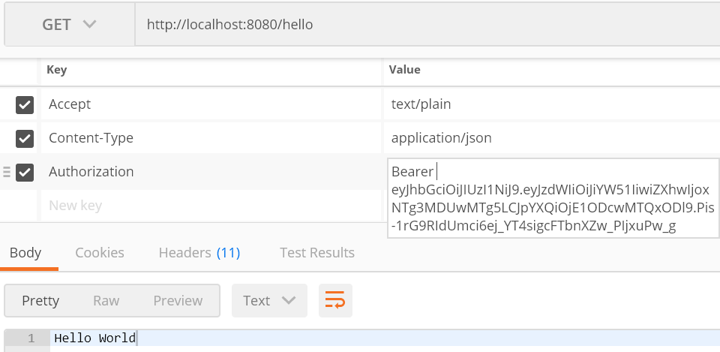
JWT: Validate Token

Slide 41
OAuth 2.0
OAuth stands for Open Authorization
OAuth2 Is a Delegation Protocol
granting access to another application to perform actions on your behalf
Actors Involved in OAuth2:
Resource Server: The server hosting user-owned resources that are protected by OAuth2.
Resource Owner: Typically, the user of the application is the resource owner. The resource owner has the ability to grant or deny access to their own data hosted on the resource server.
Authorization Server: The authorization server gets consent from the resource owner and issues access tokens to clients for accessing protected resources hosted by a resource server.
Client: An application making API requests to perform actions on protected resources on behalf of the resource owner.

Slide 42
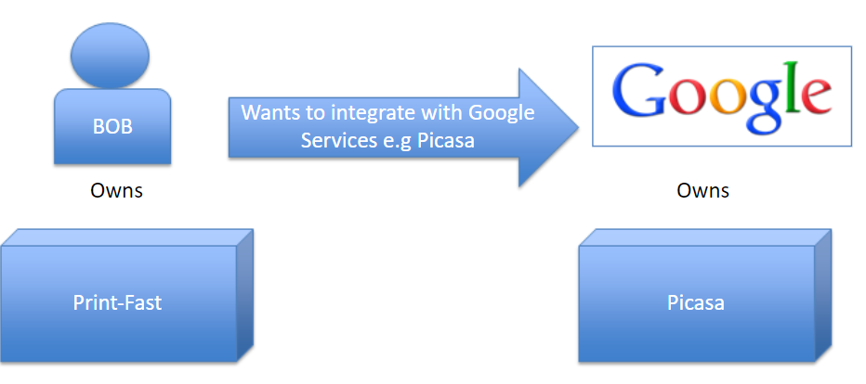
OAuth 2.0 Flow/ Authorization Code Grant
Scenario

Slide 43
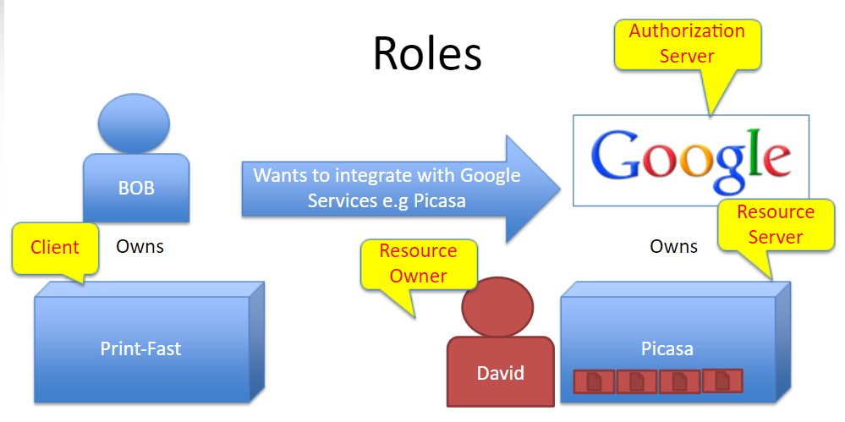
OAuth 2.0 Flow

Slide 44
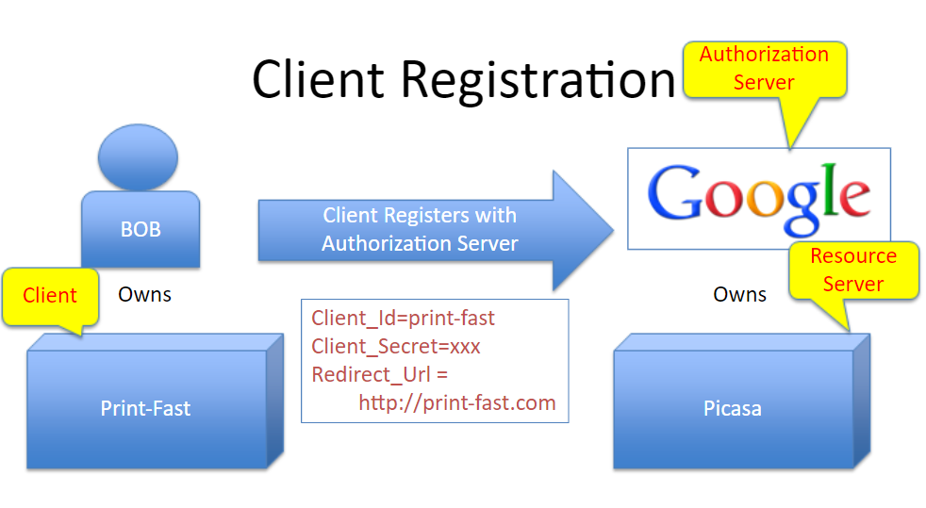
OAuth 2.0 Flow

Slide 45
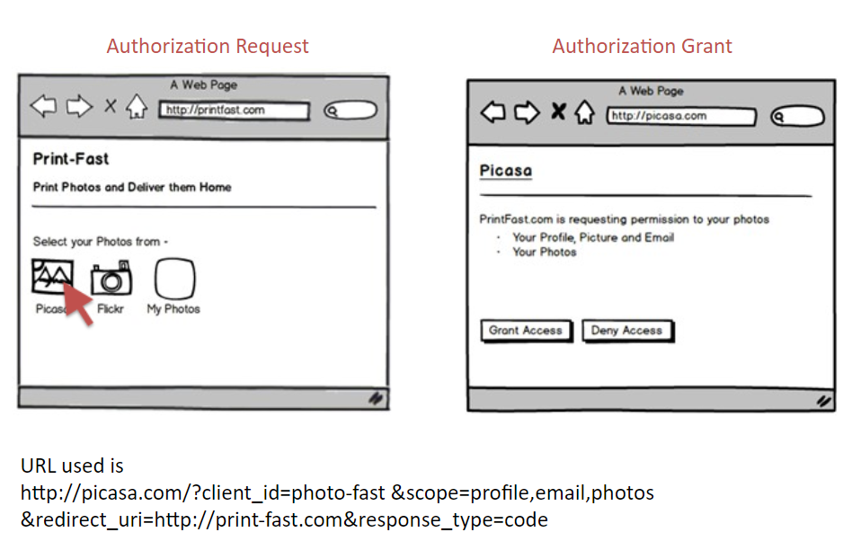
OAuth: Get Authorization Grant

Slide 46
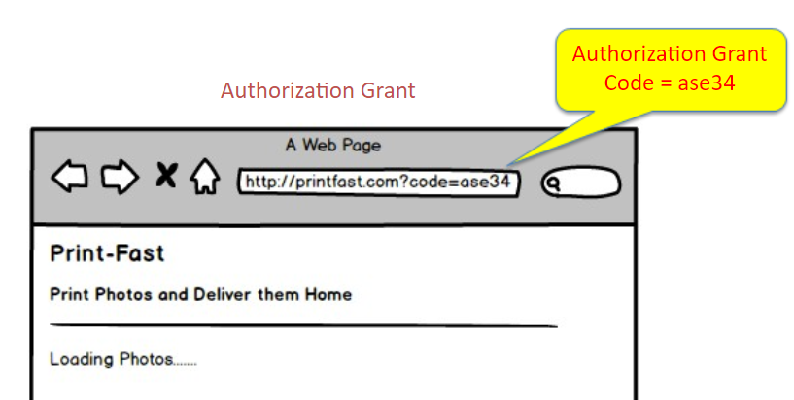

OAuth: Authorization Grant

Slide 47

Exchange Access Tokens

Slide 48

Access Protected resources

Slide 49


OAuth 2.0 Flow/ Implicit Grant Type
The Implicit flow was a simplified OAuth flow previously recommended for native apps and JavaScript apps where the access token was returned immediately without an extra authorization code exchange step.

Slide 50

OAuth 2.0 Flow/ Resource owner password credentials grant
Use cases
Strong trust between Resource owner and client
Client is supposed to store the credentials

Slide 51




Spring Boot OAuth Example
Dependencies
Register with Github Authorization Server

Slide 52




Spring Boot Oauth Example
GitHub Authorization Server
Resource Server

